Slide 1
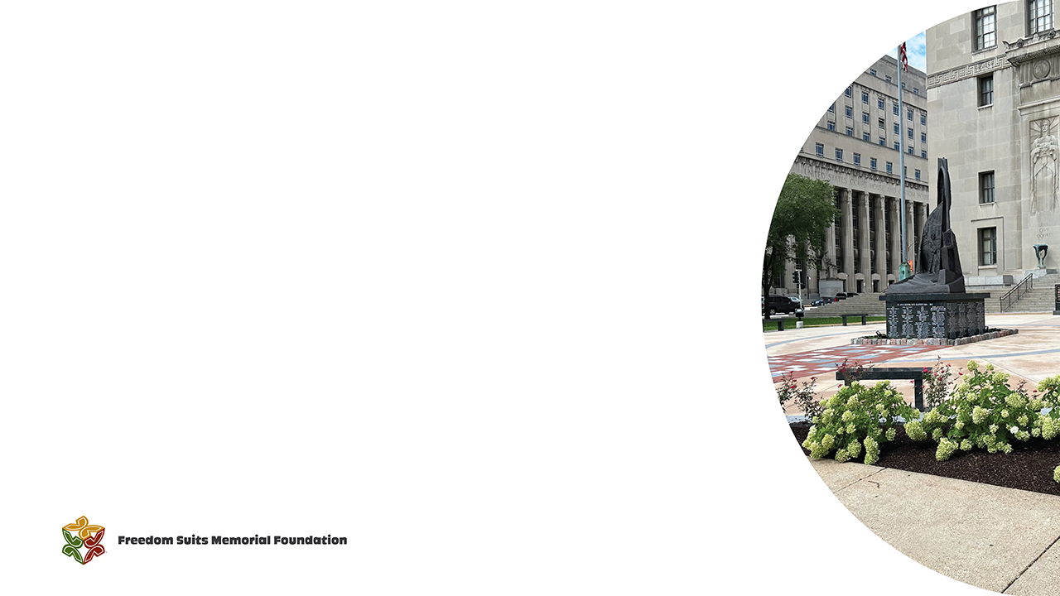
Contextualizing Dred and Harriet Scott: Teaching the St. Louis Freedom Suits
Andrea S. Boyles, Tulane University
Rob Good, University of Missouri St. Louis
Lynne Jackson, Dred Scott Heritage Foundation
Anne Twitty, Stanford University

Slide 2

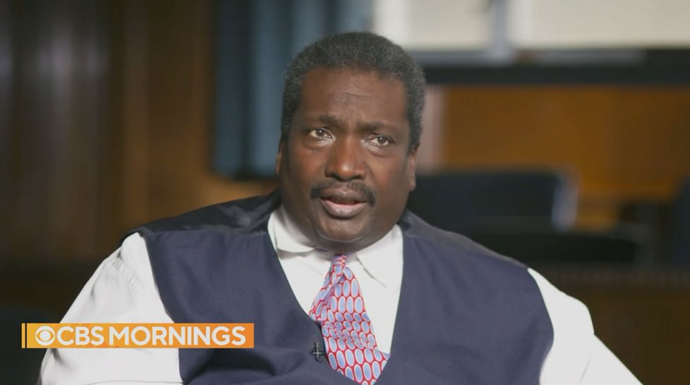
Freedom Suits Memorial Visionary: Judge David Mason

Slide 3

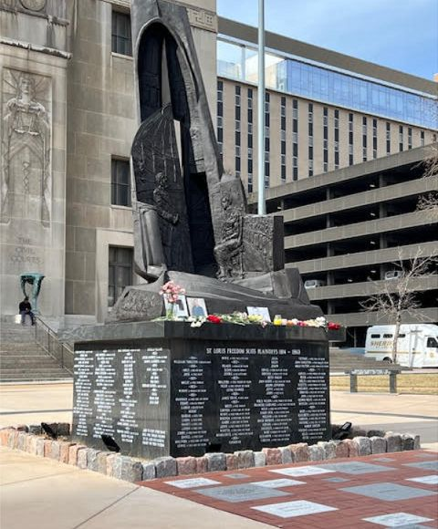
A Vision Comes to Life

Slide 4

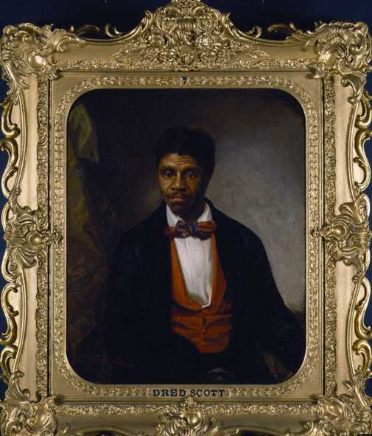
The Dred Scott Decision

Slide 5
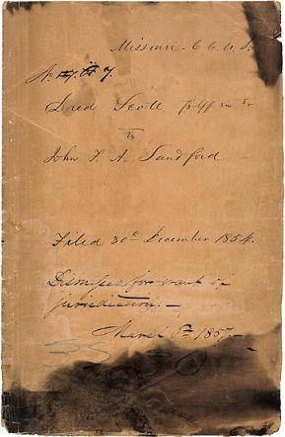
Decision Dismissing the Case March 6, 1857

Slide 6

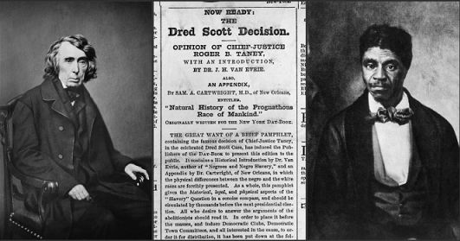
Scandal of a Nation

Slide 7
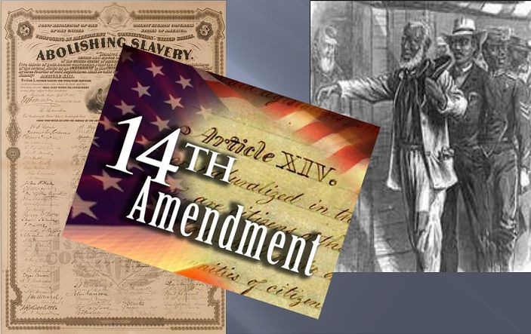
Critical Outcomes of the Dred Scott Decision

Slide 8

The Legacy Continues

Slide 9
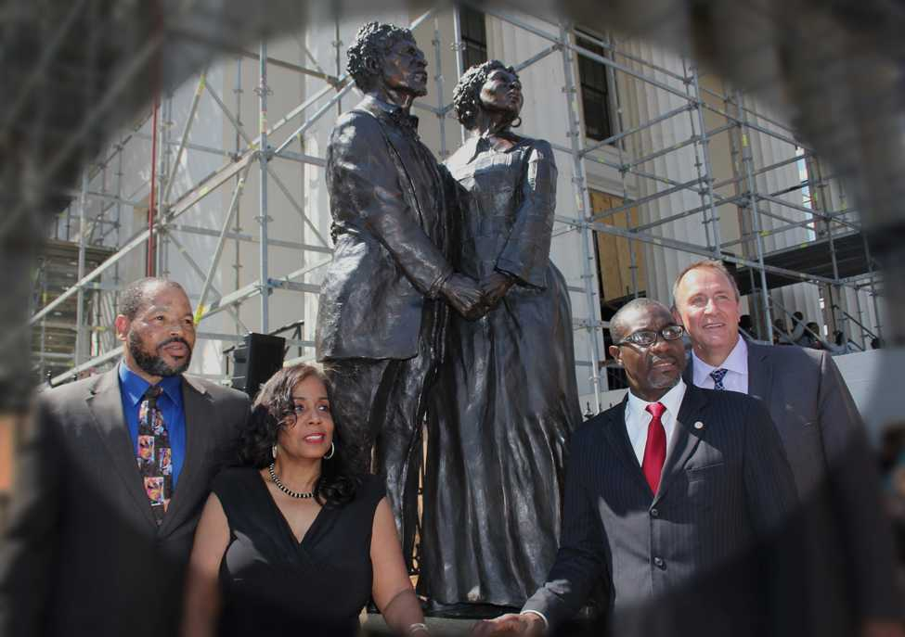
First and Only Statue of the Scotts

Slide 10
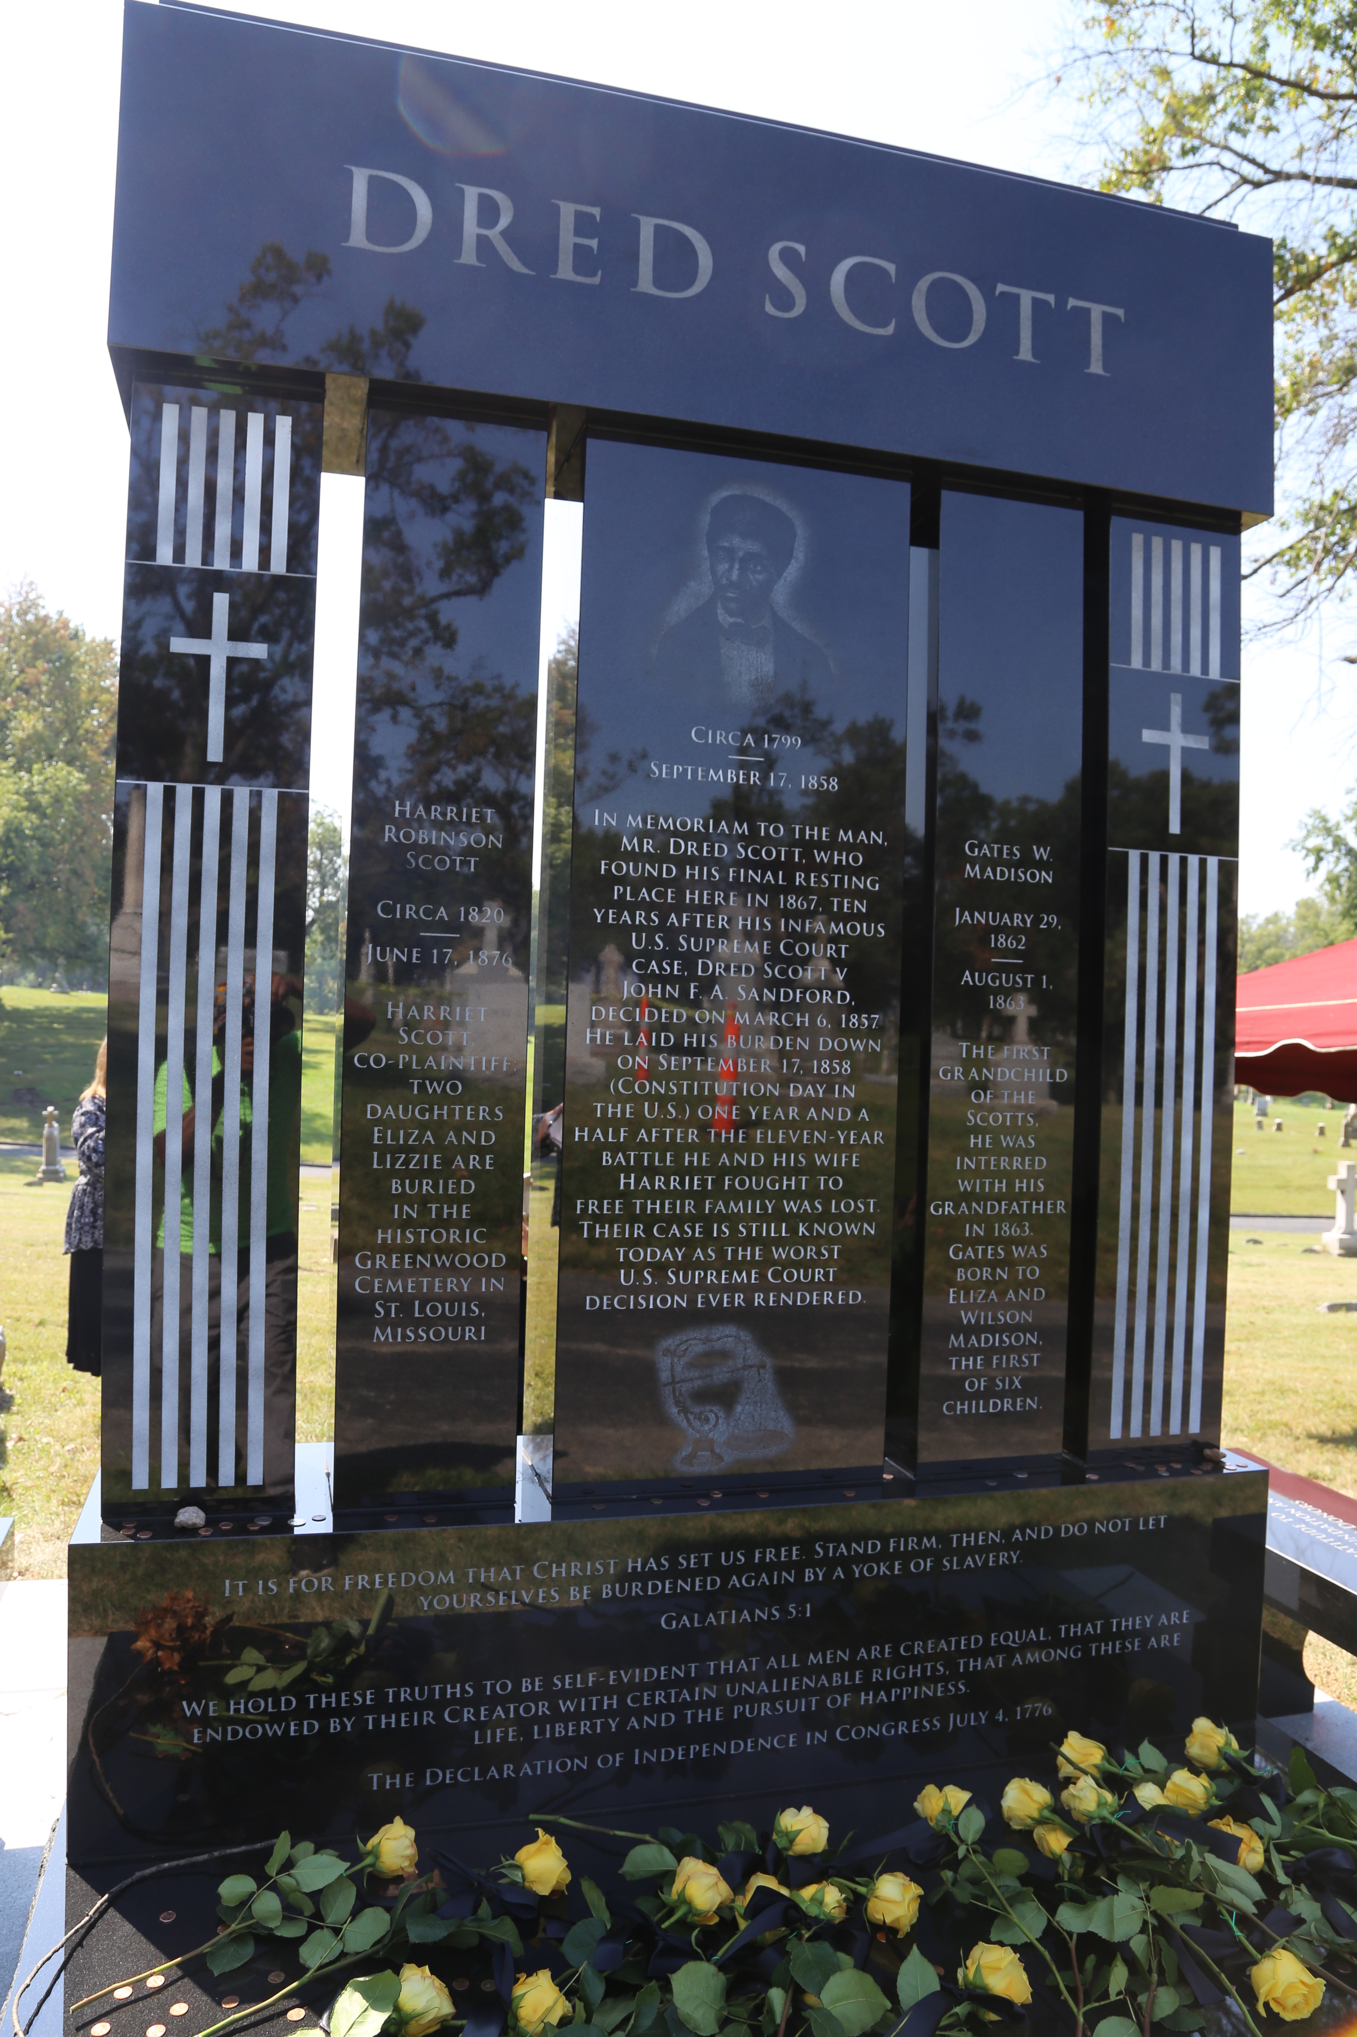
A Fitting Memorial for an Icon

Slide 11
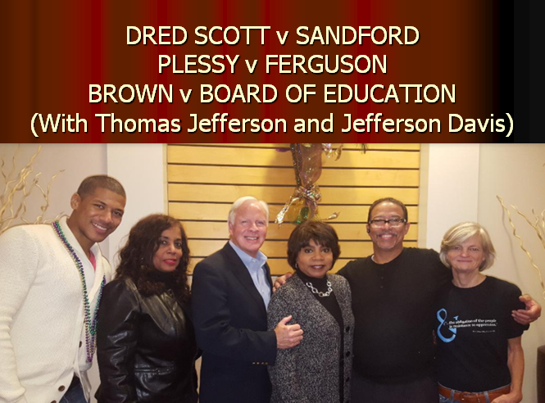
Dred Scott Presents Sons and Daughters of Reconciliation

Slide 12

Teaching the Freedom Suits in Your Classroom

Slide 13
Suing for Freedom in St. Louis The Mechanics of Freedom Suits
The right to initiate a freedom suit was established by Missouri territorial statute in 1807, but it existed in other states as well.
Plaintiffs in the St. Louis freedom suits, like plaintiffs in all freedom suits, alleged that they were free people, unlawfully held in bondage.
Cases began with a petition; once authorized plaintiffs filed an action of trespass, assault and battery, and false imprisonment.
Plaintiffs sued in forma pauperis, that is, as poor people, who had attorneys appointed to them by the court.
The law forbid defendants from removing plaintiffs from the court’s jurisdiction while their cases were pending.
Notes:
This statute also made it illegal for the plaintiff to be either removed from the court’s jurisdiction while the case was pending or “subjected to any severity because of his or her application for freedom,” and permitted judges to require defendants to enter into recognizance if they feared their orders might be violated.

Slide 14
Suing for Freedom in St. Louis The Mechanics of Freedom Suits
While their cases were pending, plaintiffs might remain in the custody of the defendant, or they might be taken into the sheriff’s custody.
Many St. Louis freedom suits ended before they went to trial, but most that reached that stage were decided by a jury rather than a judge. The only people who could serve as jurors at this time were white men.
A verdict declaring that the plaintiff was a free person would liberate them from the defendant.
In addition to obtaining their freedom, between 1824 and 1845, state statute also permitted successful plaintiffs to sue for damages.
Notes:
In the event that the defendant refused to do so, the judge was authorized to have the plaintiff taken into custody and, preferably, hired out until the case could be decided.
Finally, according to the statute, if the plaintiff was able to demonstrate—to a judge or a jury—that he or she had been wrongfully enslaved, the court had the power to free not only the plaintiff, but, if the plaintiff was a mother, and was entitled to her freedom before her children were born, any of her children as well.
The 1807 Act was subsequently revised on three occasions.
The first of these revisions took place shortly after Missouri attained statehood. This 1824 Act required, rather than merely suggested, the legal form a freedom suit would take. Thereafter would-be plaintiffs were compelled to allege trespass in addition to assault and battery and false imprisonment. More importantly, this 1824 Act permitted those whose suits were successful to claim damages “as in other cases,” essentially providing for a form of reparation for enslavement that was deemed illegal.
Subsequent changes, however, were less favorable. An 1835 revision dropped language stating that plaintiffs were allowed to bring non-written evidence before the juries who tried their cases.
And finally, in 1845, a final revision rescinded the ability of freedom suit plaintiffs to recover compensation and obligated them to find a security to cover costs in the event that they lost.

Slide 15
Suing for Freedom in St. Louis The Basis of Freedom Suits
St. Louis freedom suits were based on three grounds, with some plaintiffs claiming more than one:
Prior residence in free territory or state (73% of plaintiffs)
Free birth (40% of plaintiffs)
Previous emancipation (21% of plaintiffs)
Notes:
Note: these statistics come from Kelly Kennington’s In the Shadow of Dred Scott, 10, 79-86.
Cases that alleged prior residence in a free territory or state were based on the notion that enslaved people became entitled to their freedom as a result of an extended stay on free soil. This legal argument, known as “once free, always free” originated in Somerset v. Stewart (1772), a late-eighteenth century English freedom suit.
Other St. Louis freedom suits were based on the plaintiff’s assertion that he or she had been born free and therefore could never have been legally enslaved. Some of these individuals claimed that they hailed from free territories and states while others alleged origins in slave territories or states. Occasionally plaintiffs explicitly asserted that they had lived as free people before they were kidnapped or decoyed into slavery. Others merely mentioned that they were born in free states or territories without ever explicitly asserting that, as such, they were born free. Still more acknowledged that they had been held as slaves all their lives but argued that their mothers had either become free or been entitled to freedom by the time they were born, thereby entitling them to freedom as well.
Finally, freedom suits based on previous emancipation were generally cases in which plaintiffs asserted that they had been emancipated by deed or become entitled to freedom through an enslaver’s will but were nevertheless still held in slavery.

Slide 16
Suing for Freedom in St. Louis Freedom Suits by the Numbers
There were approximately 300 freedom suits filed in the St. Louis circuit court between 1814 and 1861. Some plaintiffs sued more than once.
More women, than men, filed freedom suits.
Most cases were filed between 1824 and 1844, the so-called “Golden Age of Freedom Suits,” when the Missouri Supreme Court routinely handed down emancipatory decisions in these cases.
Success was not assured, but many freedom suits were successful:
40.2% of freedom suit plaintiffs won their freedom
46.5% of freedom suit plaintiffs did not become free
The outcome for 13.3% freedom suits plaintiffs is unknown
Notes:
Note: statistics about the success of plaintiffs come from Anne Twitty’s Before Dred Scott. After 1845, the make-up of the Missouri Supreme Court changed, and the Court was no longer as inclined to liberate those who sued frothier freedom.

Slide 17
Suing for Freedom in St. Louis Foreshadowing Dred Scott
Many cases that closely resembled Dred and Harriet Scott’s were filed in the St. Louis circuit court.
In a series of decisions, the Missouri Supreme Court established that enslaved people who were taken to free territory became entitled to their freedom and afterwards could not be legally held as slaves even if they were returned to a slave state. The two most important of these decisions were:
Winny v. Whitesides (1824)
Rachel v. Walker (1836)
Often, the key question was whether or not an enslaver had remained in a free territory, with his or her slaves, long enough to establish a residence there.
Notes:
Note: statistics about the success of plaintiffs come from Anne Twitty’s Before Dred Scott. After 1845, the make-up of the Missouri Supreme Court changed, and the Court was no longer as inclined to liberate those who sued frothier freedom.
In Missouri, “once free, always free” was first legitimized by the state Supreme Court’s ruling in Winny v. Whitesides (1824), a freedom suit on appeal from the St. Louis circuit court that had been based on the plaintiff’s residence with her enslaver in Illinois.
In Rachel v. Walker (1836), yet another St. Louis freedom suit, the Court held that a slaveholder’s compulsory service at a military post on free soil did not protect the enslaved people he claimed from the emancipatory laws therein.
Although the Court refused to specify the exact length of time that would transform an enslaved person’s sojourn on free soil into a residence, it nevertheless asserted that any unnecessary delay while transporting enslaved people across such territory would effect their freedom.
Such precedents remained intact until the 1840s, when the court began chipping away at the notion that the Northwest Ordinance had the power to free enslaved people who resided there. As these earlier precedents were dismantled, cases based on prior residence in a free territory or state dramatically declined after 1845 and then stopped entirely after 1855.

Slide 18
Suing for Freedom in St. Louis The Plaintiffs
Most plaintiffs, like Dred Scott, had travelled widely, sometimes through forced relocation, sometimes in search of work.
They engaged in a variety of different occupations:
in domestic service
in agriculture
on board steamboats
at the salt works in southeastern Illinois
at the lead mines in northwestern Illinois
Many had been “hired out,” sometimes for years at a time.

Slide 19
Suing for Freedom in St. Louis Why St. Louis?
Located on the border of a border state in an expanding nation, St. Louis’s geography made it a natural site for freedom suits.
The city’s circuit court was subject to the emancipatory rulings handed down by Missouri’s Supreme Court.
The city’s attorneys proved willing—even eager—to represent freedom suit plaintiffs.
Urban slavery, and the practice of hiring out, provided enslaved people with the autonomy they needed to access the legal system.
Notes:
St. Louis was an obvious site for these battles to take place. The city’s size and growing importance, after all, drew thousands of new inhabitants every year while its location ensured that a number of slaves who were drawn into its orbit had already spent time on the nominally free soil of the Northwest Territory, an experience that would enable them
to prosecute a freedom suit.
Its circuit court, moreover, was subject to a variety of emancipatory precedents established by the Missouri Supreme Court over the course of the early national and antebellum eras.
The city itself boasted a large population of attorneys who proved more than willing to represent those who sued for their freedom.
The widespread practice of hiring out, meanwhile, common in the region as a whole, but even more prevalent in a city like St. Louis, meant that enslaved people in the city, like urban slaves elsewhere, had greater autonomy from their masters than their counterparts in the countryside and, therefore, better access to both the judicial system and legal representation.

Slide 20
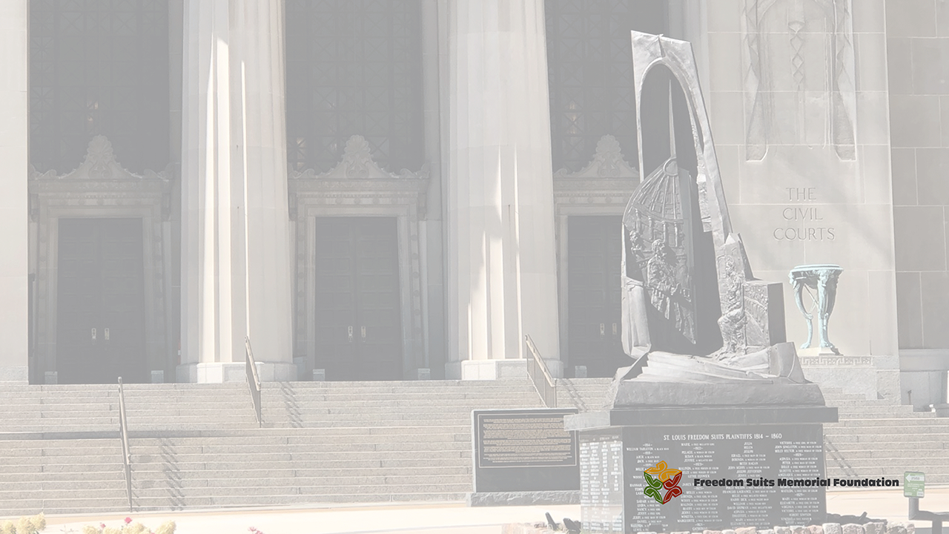
Key Takeaways
The significance of Storytelling
"...the first opportunity for black folks to represent themselves as anything other than property..."
- Virginia Hamilton, The People Could Fly
"...our roots and wings." - Andrea Collier 2019
Connecting the past, present, and imagined future
Context matters
Thematic and historical preservation
Discussion

Slide 21
