Slide 1

Gateway to Westward Expansion
Using Active Learning to Explore Economics & History
March 21, 2025

Slide 2
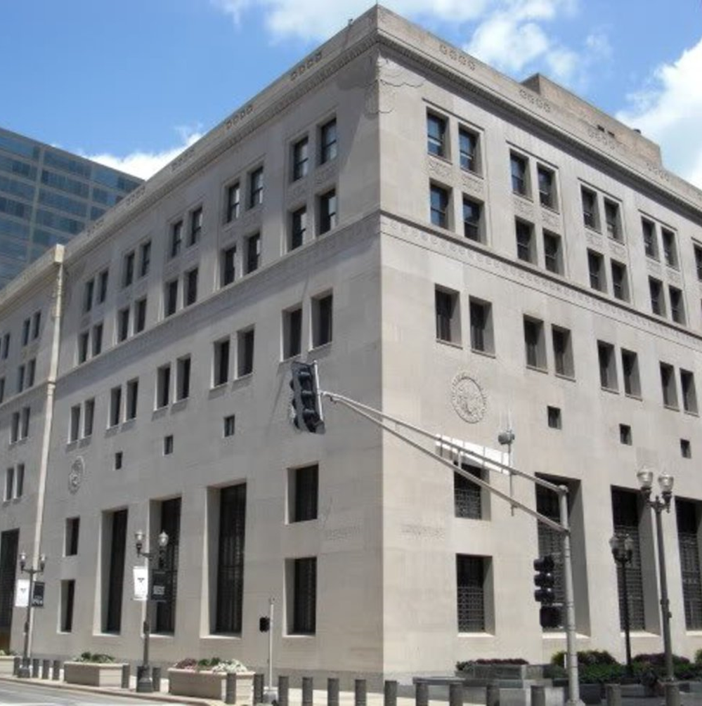
Disclaimer
The opinions expressed here do not necessarily reflect those of the Federal Reserve System or the FRB of St. Louis
Any comments, questions, feedback from participants must be appropriate & professional

Slide 3

About Me
Senior Economic Education Specialist, Federal Reserve Bank of St. Louis
20 years classroom teaching experience @ Timberland HS (AP US History, AP Econ, Pop Culture in the 20th Century)
Email: mike.kaiman@stls.frb.org

Slide 4
Agenda
Disrespecting the dismal science
Page one reading
Learning activity
Other stl fed history resources
Q & A

Slide 5

Disrespecting the Dismal Science: Challenges for teaching econ in social studies
Common complaints
It’s hard
Nobody understands it
I don’t have time
Counterargument
State standards/curricula are FULL of econ
Academic theory vs. practical examples
Lecture vs. active learning
St. Louis Fed resources make it easy
www.stlouisfed.org/eduation
Notes:
Abby.Anderson@stls.frb.org

Slide 6
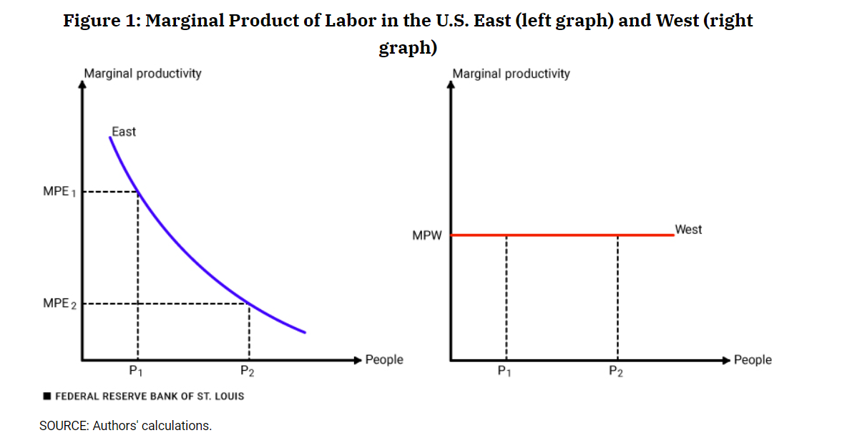
Page One Economics: Marginal Product of Labor & W. Expansion
What are the factors of production?
Land + labor + capital = productivity
Assume an agricultural American economy:
Land space is fixed…ish
Labor does basically the same work
Question of where best to put those workers
Introducing total / average / marginal analysis
Workers only part of the story
Agricultural based economies need land
Marginal Product of Labor
∆ TP / ∆ L
Use US history as explaining vehicle

Slide 7
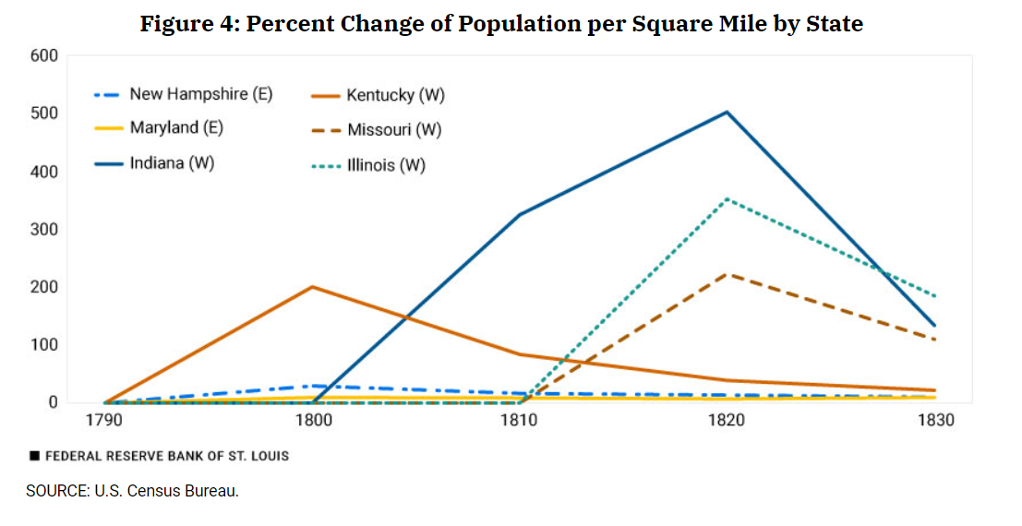
Marginal Product of Labor & Census Data
What is the trend line of eastern states? (New Hampshire, Maryland)
Relatively flat
Indicating stagnant MPL
What happens with each new western state (KY, IN, IL, MO) added?
Massive growth in 1st decade
Slower (but still) growth in successive censuses
Indicates increase MPL

Slide 8
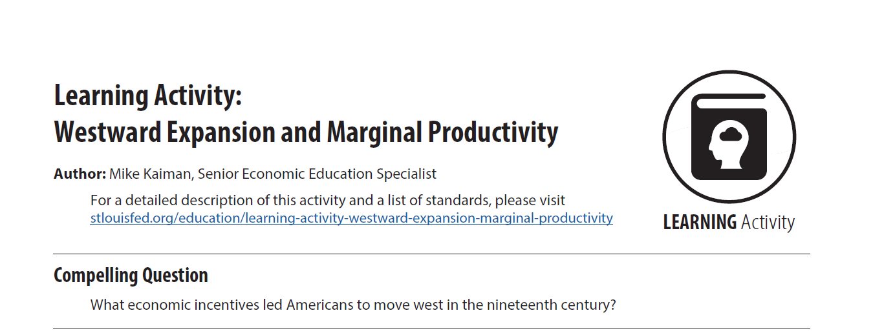
Making the Abstract Obvious Learning Activity
It’s one thing to assign a reading…
Promote “student centered discourse”
Be a “guide on the side.”
Pedagogical research supports stance
Student engagement, retention and application rates all increase
“Make the brain active, not the person.” (Nesra Yannier, Science 2021)

Slide 9
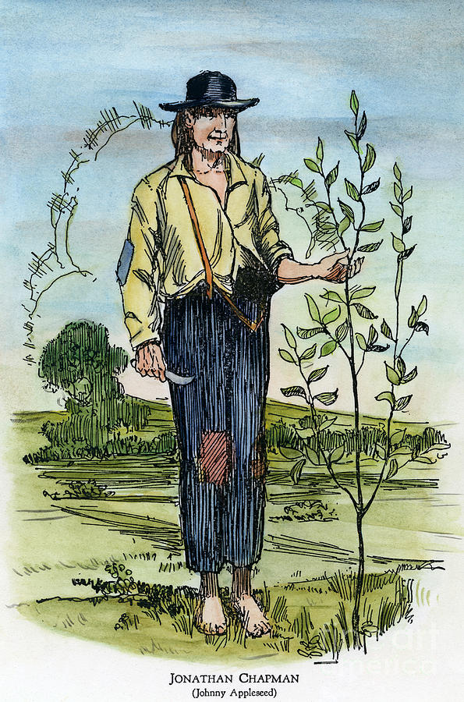
Making the Abstract Obvious Learning Activity
Eastern State
(NOTE: Each square produces 100 bushels of apples)
 | TOTAL | AVERAGE PRODUCTIVITY | MARGINAL PRODUCTIVITY
Farmer 1
Farmer 2
Farmer 3
Farmer 4
Farmer 5
Farmer 6
600
600
--
1000
500
400
Farmer
1
Farmer
1
Farmer
1
Farmer
3
1300
433 1/3
300
Farmer
1
Farmer
1
Farmer
1
Farmer
3
1500
375
200
Farmer
2
Farmer
2
Farmer
4
Farmer
3
1600
320
100
1600
266 2/3
0
Farmer
2
Farmer
2
Farmer
4
Farmer
5

Slide 10
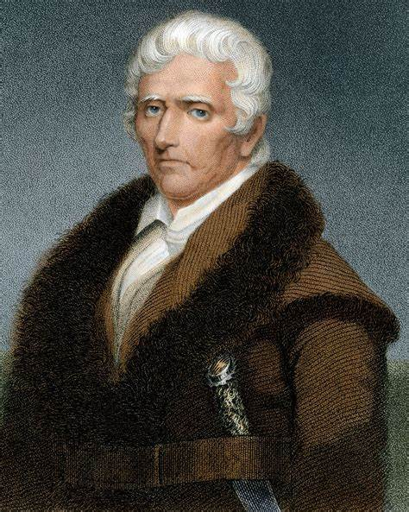
Making the Abstract Obvious Learning Activity
Western State
(NOTE: Each square produces 100 bushels of apples)
 | TOTAL | AVERAGE PRODUCTIVITY | MARGINAL PRODUCTIVITY
Farmer 7
Farmer 8
Farmer 9
Farmer 10
Farmer 11
Farmer 12
Farmer 13
Farmer 14
Farmer
7
Farmer
7
Farmer
7
Farmer
8
Farmer
8
Farmer
8
Farmer
9
Farmer
9
Farmer
9
Farmer
10
Farmer
10
Farmer
10
300
300
--
600
300
300
900
300
300
1200
300
300
Farmer
11
Farmer
11
Farmer
11
Farmer
12
Farmer
12
Farmer
12
Farmer
13
Farmer
13
Farmer
13
Farmer
14
Farmer
14
Farmer
14
1500
300
300
1800
300
300
2100
300
300
2400
300
300

Slide 11
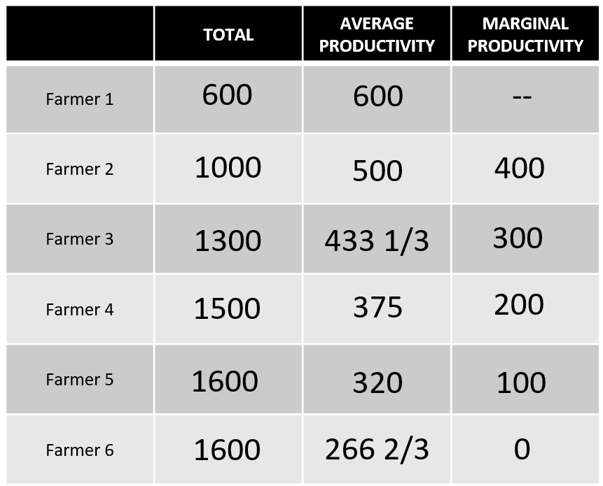
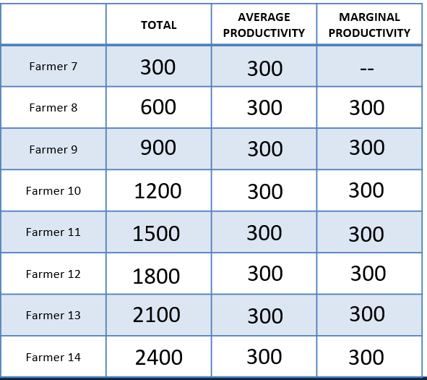
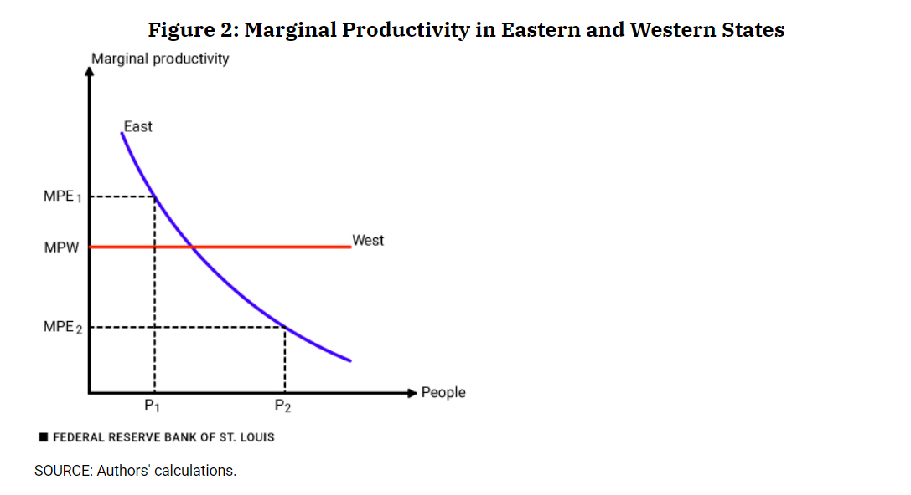
MPL & Westward Expansion Takeaways
Should farmer 5 stay East or move West?
Move as 100 MPL is < 300 MPL
Which Eastern farmers have an incentive to move?
Farmers 4 – 6 should move
Farmer 3 is indifferent
What will happen to the eastern land abandoned by farmers 4 – 6?
Opens discussion to industrialization, etc.

Slide 12

Additional Resources: FRASER
Explore Educator Resources, Themes & More
Activity: 75 Years of American Finance
Activity: The Free Silver Movement
Activity: Historical Inquiry w/ 1870 Statistical Atlas

Slide 13
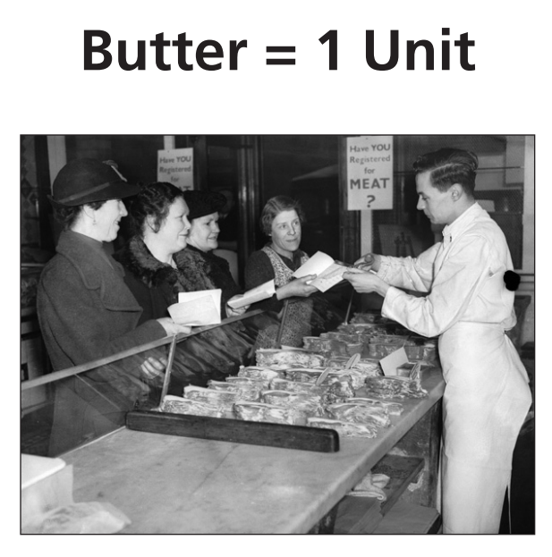
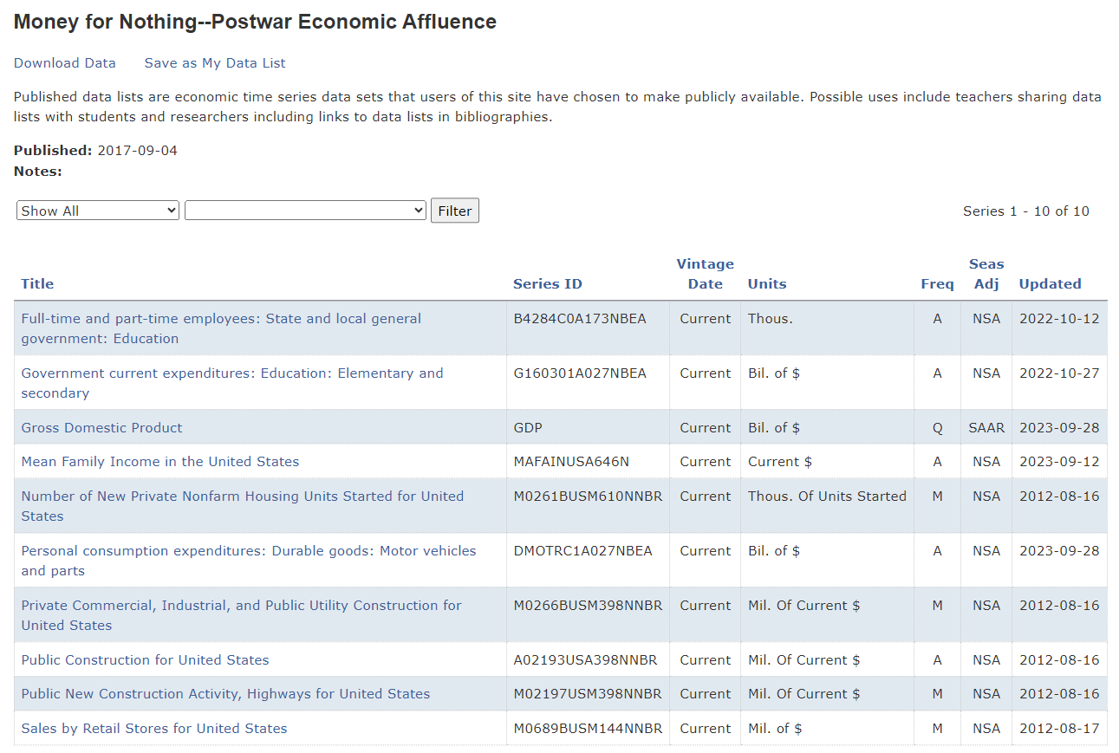
Additional Resources: Carrying It Forward
Arsenal of Democracy
Guns v. Butter debate w/ propaganda poster analysis
Money for Nothing
Postwar affluence using FRED® data sets
Removing the “Punch Bowl”
Birth of modern monetary policy

Slide 14
THANK YOU
Mike Kaiman
Mike.kaiman@stls.frb.org

